Slide 1
NIH Data Management Plans; Dryad Data Repository
Phil Hurvitz Jenny Muilenburg
CSDE Workshop 2023-05-24

Slide 2
NIH Data Management Plans
Phil Hurvitz Research Scientist Center for Studies in Demography and Ecology University of Washington
CSDE Workshop 2023-05-24

Slide 3
Overview
What is this workshop about?
New NIH requirements for Data Management and Sharing (DMS) Plans: effective Jan 25, 2023
Your responsibilities as a researcher
Proposals for funding
During performance period
After performance period is complete
Other online resources
Options for long-term storage and dissemination of research data at UW (Dryad, QDR)

Slide 4
What is this workshop?
An overview of the new NIH policy on Data Management and Sharing (DMS) Plans.
Not a complete treatment of the topic
Highlights only; see Other Resources, FAQ, etc.
Does not cover Genomic Data Sharing; see specific NIH materials
Introduction to Dryad Data Repository for long-term storage of shareable research data

Slide 5
New NIH requirement
Effective Jan 25, 2023 (i.e., now effective for all new research proposals)
All proposals for research funding must include a section on “Data Management and Sharing”
Proposals with no DMS Plan will not be accepted/reviewed
Recommended DMS Plan to be no more than 2 pages
DMS Plans are NOT visible to peer reviewers unless the FOA has a data sharing focus
DMS Plans are therefore not scored on pink sheets

Slide 6
New NIH requirement
Why is this being required?
“Consistent with both the NIH mission to improve public health through research and its longstanding legislative mandate to make available to the public the results of the research activities that it supports and conducts the NIH believes that the full value of GWAS to the public can be realized only if the genotype and phenotype datasets are made available as rapidly as possible to a wide range of scientific investigators.”
https://grants.nih.gov/grants/guide/notice-files/NOT-OD-07-013.html

Slide 7
New NIH requirement
Why is this being required? Alias: how to make peace with these new requirements
May be interpreted as “yet another hoop to jump through” or “yet another administrative requirement”
Best thought of as a way to increase the impact of NIH-funded research
Increases the shorter-term burden on individual researchers, but in the long run benefits all researchers and society in general

Slide 8
New NIH requirement
What needs to be shared?
“Recorded factual material… of sufficient quality to validate and replicate research findings, regardless of whether the data are used to support scholarly publications”
What not to share
Lab notebooks
Preliminary analyses
Peer reviews
Physical objects

Slide 9
New NIH requirement
What may limit data sharing? Ethical, legal, and technical considerations, e.g.,
Informed consent may not permit or may limit scope of sharing or use
Explicit federal, state, local, or Tribal law, regulation, or policy may prohibit disclosure
What is not justifiable for limiting sharing? E.g.,
Dataset is too small
Researchers anticipate data will not be widely used
Data are not thought to have a suitable repository

Slide 10
New NIH requirement
Applies to all research generating scientific data, including:
Research Projects
Some Career Development Awards (K series)
Small Business SBIR/STTR
Research Centers

Slide 11
New NIH requirement
Does not apply to research and other activities that do not generate scientific data, including:
Training (T series)
Fellowships (F series)
Construction (C06)
Conference Grants (R13)
Resources (G series)
Research-Related Infrastructure Programs (e.g., S06, S10)

Slide 12
Your responsibilities as a researcher
Proposals for funding
During performance period
After performance period is complete

Slide 13
Your responsibilities as a researcher: proposals
Proposals for funding: Data Management and Storage (DMS) Plan must be included in your proposal
Budgeting

Slide 14
Your responsibilities as a researcher: proposals/DMS
Applications require a complete and acceptable DMS Plan
Recommended to be no more than 2 pages
May be longer than 2 pages if awards support a variety of activities or generate a lot of data sets

Slide 15
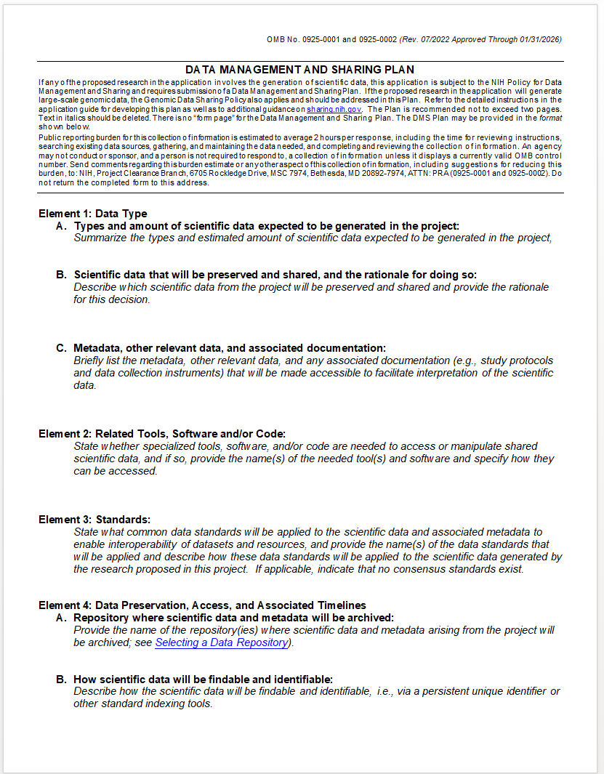
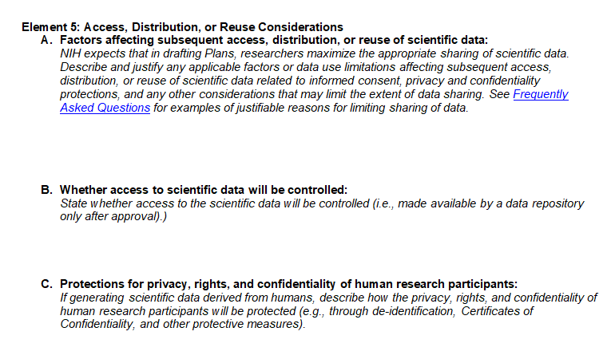
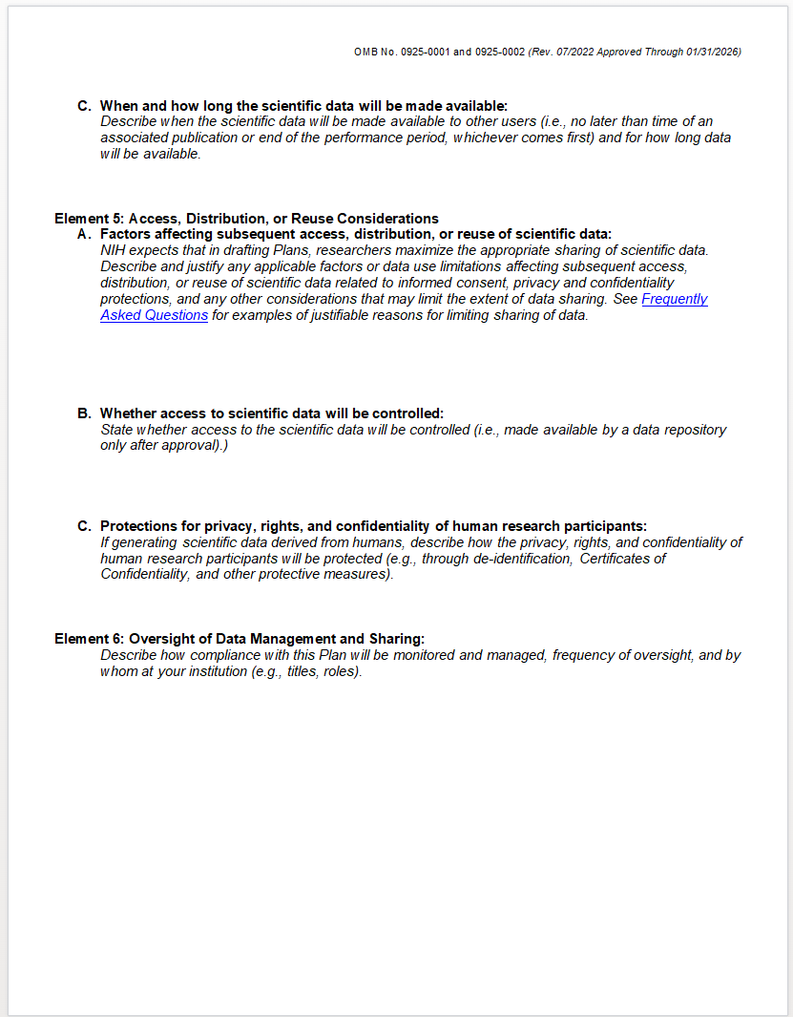
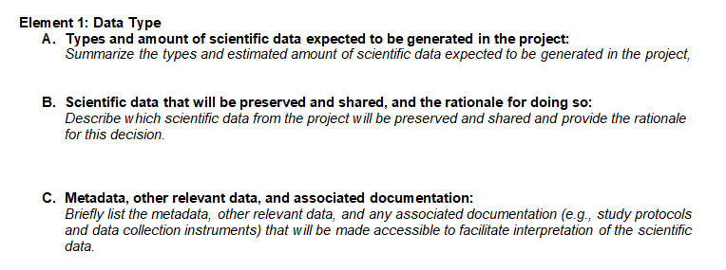
Your responsibilities as a researcher: proposals/DMS
Example template
PII? PHI?

Slide 16
Your responsibilities as a researcher: proposals/DMS
Example text from NIH:

Slide 17
Your responsibilities as a researcher: proposals/DMS
Format/templates are available
Human clinical and/or MRI data (NIMH)
Human genomic data (NIMH & NHGRI)
Human & non-human genomic data (NIMH)
Secondary data analysis (NIMH)
Human clinical and genomics data (NICHD)
Human survey data (NICHD)
Model organism (Zebrafish) data (NICHD)
Technology development (NHGRI)

Slide 18
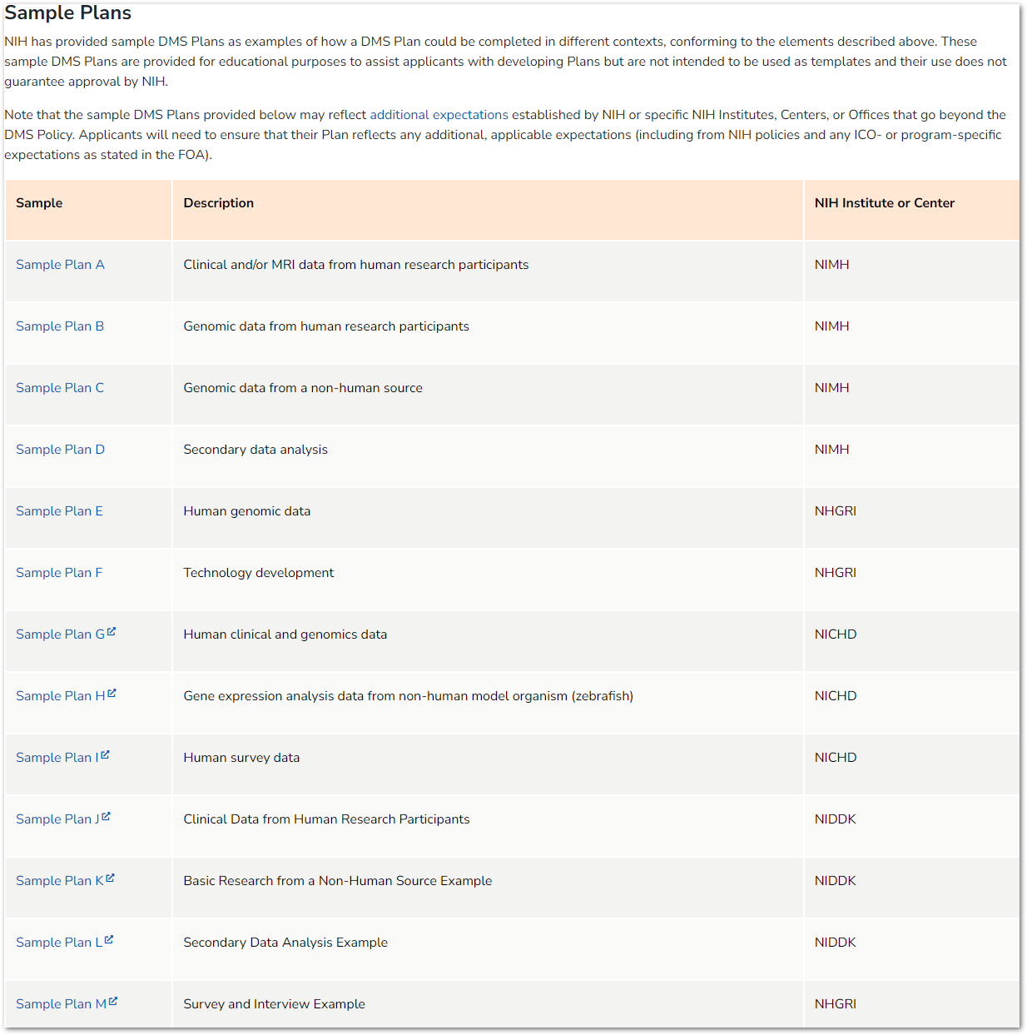
Your responsibilities as a researcher: proposals/DMS
Sample DMS templates: https://bit.ly/3Wrqtsh

Slide 19
Your responsibilities as a researcher: proposals/budget
Your budget should cover costs related to DMS Plans
You cannot request funds for DMS activities to be spent beyond the award end date—expenditures must be incurred during the performance period
You cannot fund future data storage costs on an expired budget!
Be aware of allowable and unallowable costs

Slide 20
Your responsibilities as a researcher: proposals/budget
Allowable costs
Curating data/developing supporting documentation
Preserving/sharing data through repositories
Local data management considerations
Unallowable costs
Infrastructure costs typically included in indirect costs
Costs associated with the routine conduct of research (e.g., costs of gaining access to research data)

Slide 21
Your responsibilities as a researcher: proposals/budget
R&R Budget Form
PHS 398 Modular Budget Form
Data Management and Sharing Costs

Slide 22
Your responsibilities as a researcher: proposals/budget
Although the actual DMS Plan is not visible to peer reviewers, include ≤ 1/2 page within your budget justification, which is peer reviewed
Reviewers may comment on DMS costs based on budget justification

Slide 23
Your responsibilities as a researcher: performance period
Approved DMS Plan becomes a term and condition of award
Data sharing must be implemented no later than (whichever comes first):
First publication
End of award period
DMS Plans may be updated throughout award lifecycle if revisions are necessary
Changes must be approved by Officer
DMS Plan is part of RPPR
DMS Plan is reviewed annually

Slide 24
Your responsibilities as a researcher: post-performance
Little documentation exist so far “Recipients generally must retain financial and programmatic records, supporting documents, statistical records, and all other records that are required by the terms of a grant, or may reasonably be considered pertinent to a grant, for a period of 3 years from the date the annual FFR is submitted. For awards issued under the SNAP authorities, the three-year retention period is calculated from the date the FFR is submitted for the entire competitive segment.”
Optimally a data and code repository will remain in perpetuity
Repositories, DOI, etc.
https://grants.nih.gov/grants/post-award-monitoring-and-reporting.htm

Slide 25
Other (online) resources
FAQ: https://sharing.nih.gov/faqs#/data-management-and-sharing-policy.htm
Final NIH Policy for Data Management and Sharing https://grants.nih.gov/grants/guide/notice-files/NOT-OD-21-013.html

Slide 26
Policy and Supplemental Information
NOT-OD-21-013 – Final NIH Policy for Data Management and Sharing
NOT-OD-21-014 – Supplemental Information to the NIH Policy for Data Management and Sharing: Elements of an NIH Data Management and Sharing Plan
NOT-OD-21-015 – Supplemental Information to the NIH Policy for Data Management and Sharing: Allowable Costs for Data Management and Sharing
NOT-OD-21-016 – Supplemental Information to the NIH Policy for Data Management and Sharing: Selecting a Repository for Data Resulting from NIH-Supported Research

Slide 27
Additional slides from NIH

Slide 28
Relevant Notices
NOT-OD-22-189 – Implementation Details for the NIH Data Management and Sharing Policy (August 5)
NOT-OD-22-195 – New NIH "FORMS-H" Grant Application Forms and Instructions Coming for Due Dates on or after January 25, 2023 (August 8)
NOT-OD-22-198 – Implementation Changes for Genomic Data Sharing Plans Included with Applications Due on or after January 25, 2023 (August 31)
NOT-OD-22-213 – Supplemental Information to the NIH Policy for Data Management and Sharing: Protecting Privacy When Sharing Human Research Participant Data (September 21)
NOT-OD-22-214 – Supplemental Information to the NIH Policy for Data Management and Sharing: Responsible Management and Sharing of American Indian/Alaska Native Participant Data (September 21)

Slide 29
Informed Consent and DMS Policy
Policy encourages researchers and institutions to establish robust consent processes, but:
Does not establish additional consent expectations
Does not require consent be obtained any particular way (e.g., broad consent)
Policy recognizes limitations on data sharing based on the informed consent process
Informed Consent Resources:
Points to consider
Sample language for future use and/or data sharing
Informed Consent Resource

Slide 30
Supplemental Information for Protecting Privacy When Sharing Human Research Participant Data
Provides a basic framework for considering how to protect privacy when sharing data from human participants
Not intended as a guide for regulatory compliance
Broadly applicable to different research contexts
Establishes shared principles, provides best practices, and offers considerations for determining whether to control access to data
NOT-OD-22-213

Slide 31
Supplemental Information: Responsible Management and Sharing of American Indian/ Alaska Native Participant Data
Information to assist in developing appropriate DMS Plans
Best Practices for Responsible Management and Sharing of AI/AN Participant Data
Emphasizes:
Respect for Tribal Sovereignty
Partnerships and mutual agreements
Building trust
Developed through Tribal Consultation and stakeholder engagement beginning in 2019
NOT-OD-22-214

Slide 32
Research Data Management and Dryad
CSDE
Jenny Muilenburg
Research Data Services Librarian
May 24, 2023
32 of 46

Slide 33
UW Data Repositories
Introduction to Dryad & QDR
Demo & support
Q&A

Slide 34
What’s included?

Slide 36
Where to Share
National repositories like the National Center for Biotechnology Information or one from the NIH list of approved sharing repositories
Community-sponsored websites like the Neuroscience Information Framework
An generalist repository, such as UW's Dryad
QDR

Slide 37
NIH DMSP Resources
A checklist for researchers using the DMSP
DMPTool. Provides text-based templates, generates a 2-page text document.
Membership with data repository Dryad, free to UW researchers to use to openly share data, and one of NIH’s recommended generalist repositories.
Membership with QDR for qualitative data
Notes:
\

Slide 38
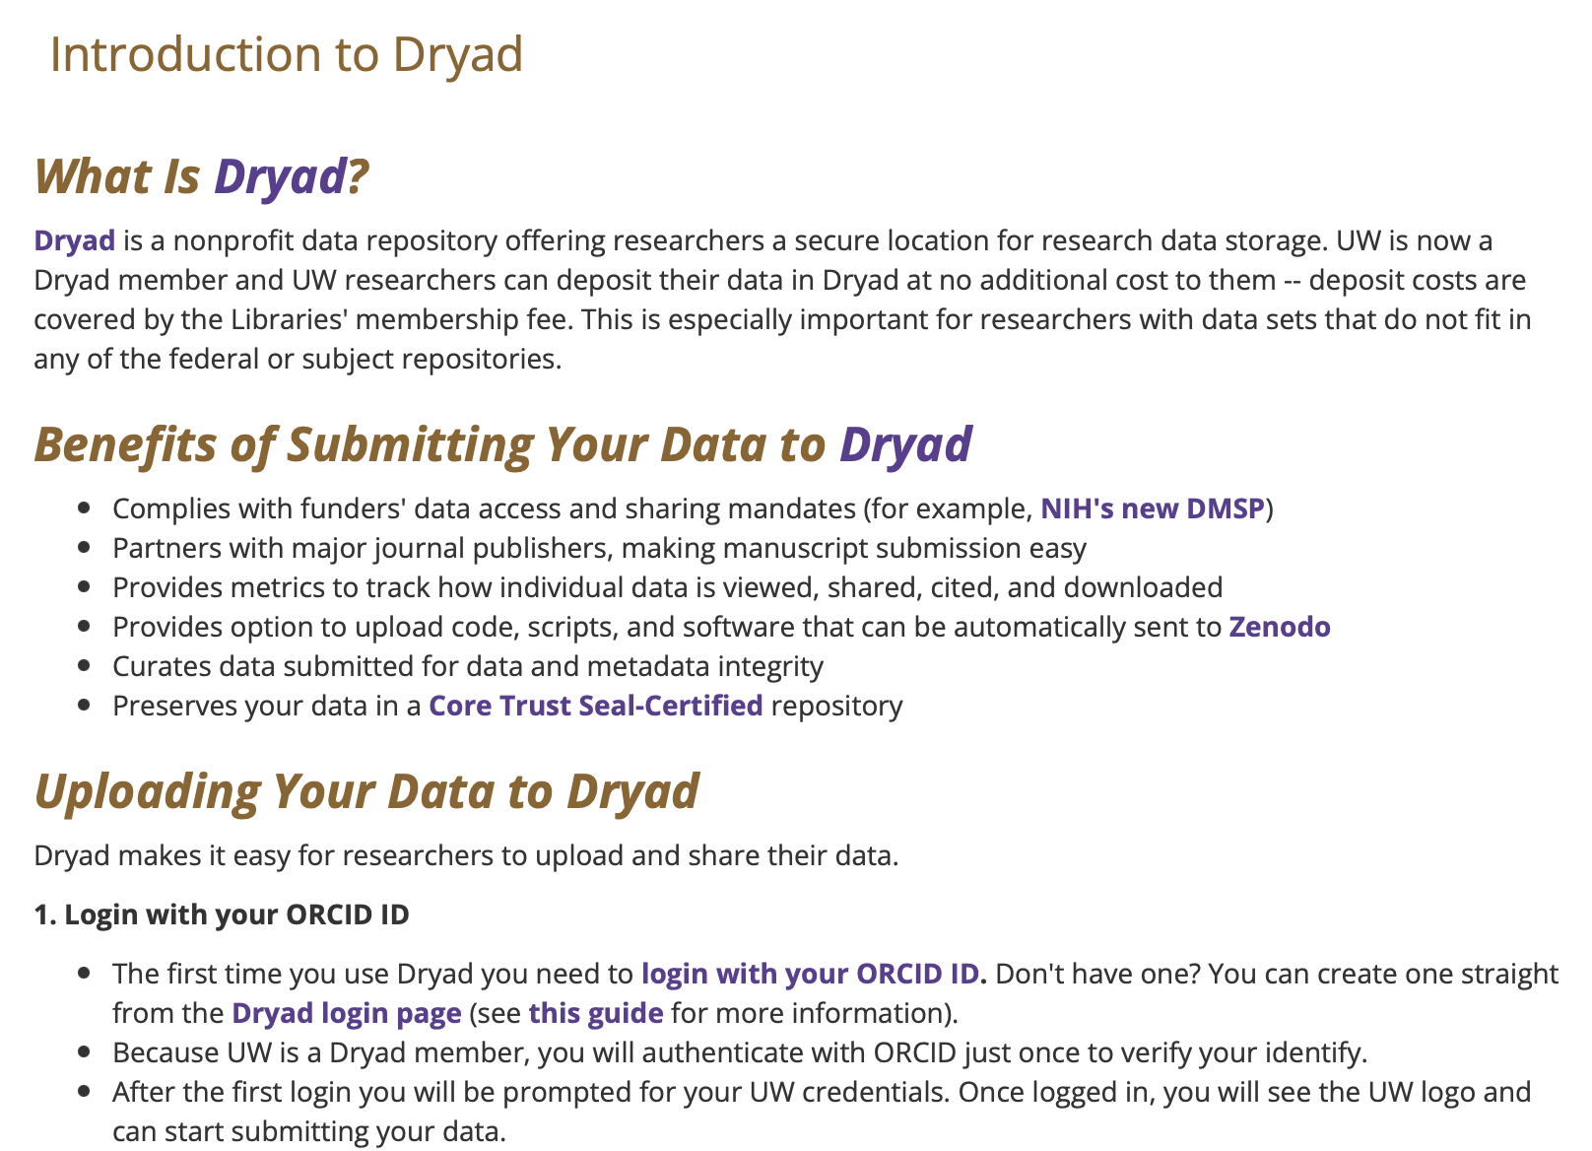
Dryad

Slide 39
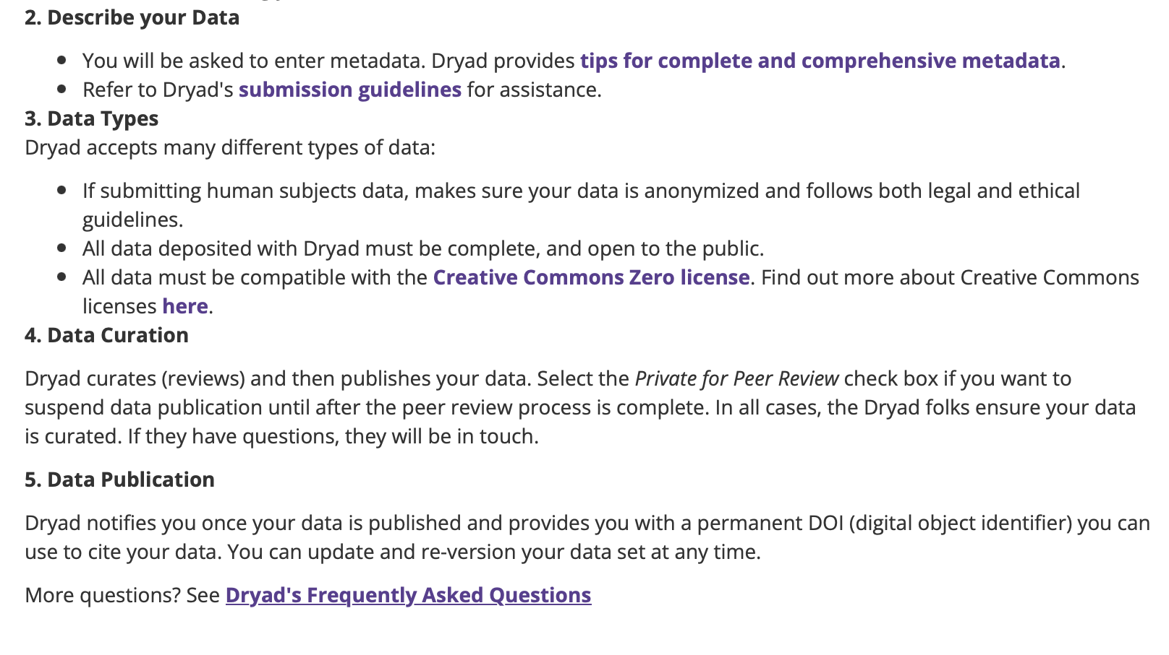

Slide 40
Dryad
Data must not have any PII/sensitive data
Data must be licensed with a CC0 1.0 license (basically in the public domain)
Login with ORCID, thereafter UW netid
Demo
Example dataset
Notes:
If you choose to create a new DMP, you will be brought to a list of DMP templates based on funding agency. Fill in the template, and at the end the website will format your answers into a completed PDF or Word doc.

Slide 41
Qualitative Data Repository (QDR)
Qualitative Data Repository
For qualitative data that requires more in-depth curation
For data that requires access controls

Slide 42
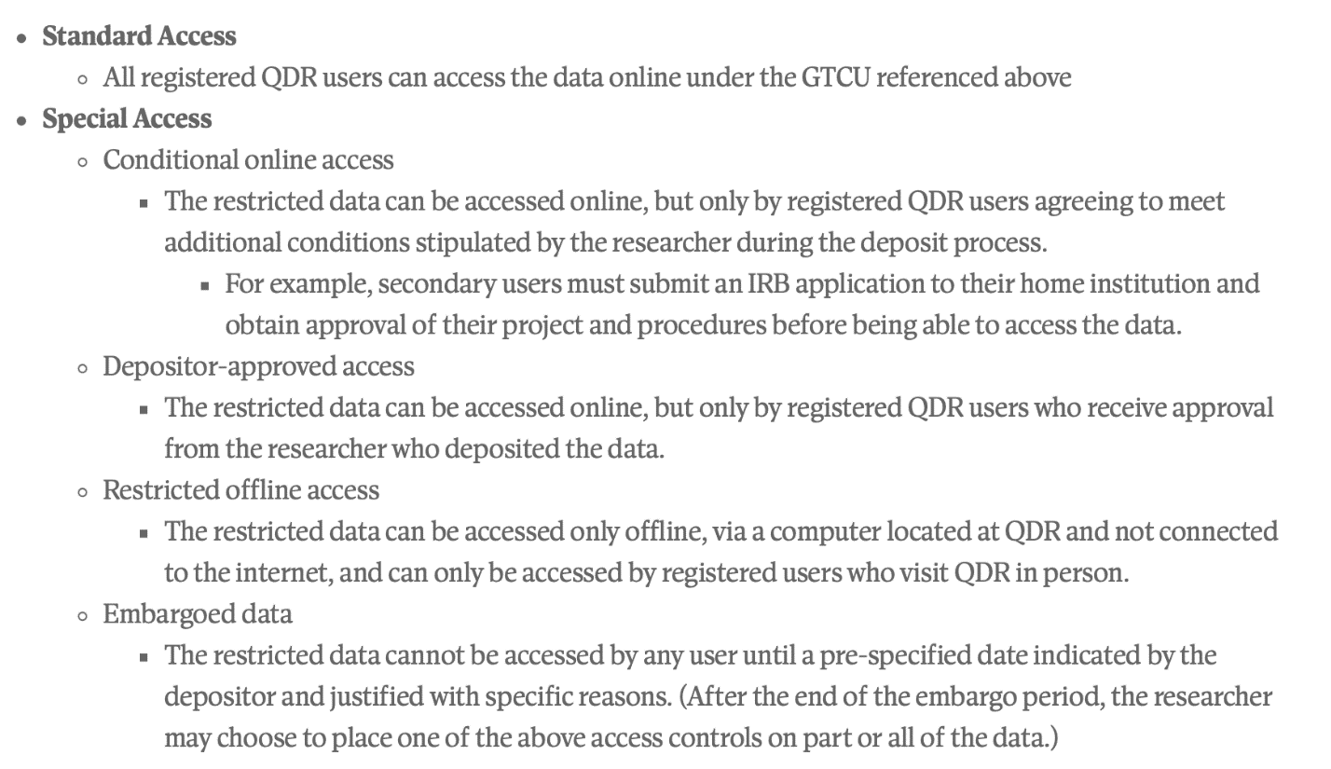
QDR access controls

Slide 43
Open Science/Open Research
UW’s OA policy
Open Access @ UW
How do I make my articles open?
Related: UW Reproducibility and Open Research group

Slide 44
NIH DMSP Resources
UW NIH resource page
Presentation at November 2022 MRAM meeting
05 Certificates of Confidentiality and Data Sharing.MRAM_.11.10.22.pptx
04 NIH DMS Policy and Forms H.MRAM_.11.10.22.pptx

Slide 45
Q & A
Jenny Muilenburg jmuil@uw.edu
Phil Hurvitz, phurvitz@uw.edu

