Slide 1
CSDE: A Brief History of the First Fifty Years by
Charles Hirschman, Professor Emeritus
Notes:
Marvin Oliver – UW professor
CSDE anniversaries, not 25th, I may be only UW faculty member who spoke at both 25 and 50 – only surviving, not available for 100th

Slide 2
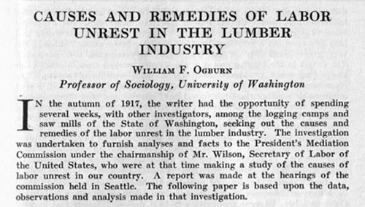
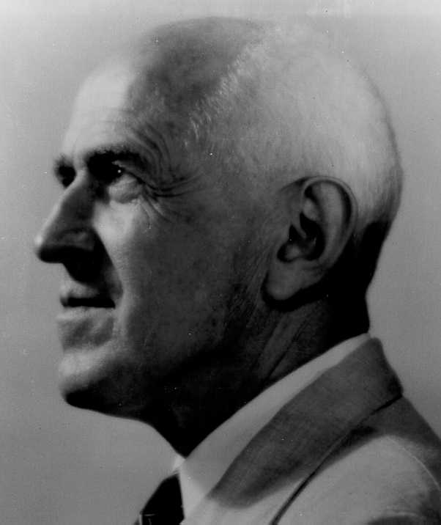
A Bit of Prehistory
William Ogburn 1886-1959
UW Sociology Chair, 1917-18
Notes:
Only one year – but set a high standard with appointment, Known for theory of social change, statistics, national leader, Little known article on labor unrest

Slide 3
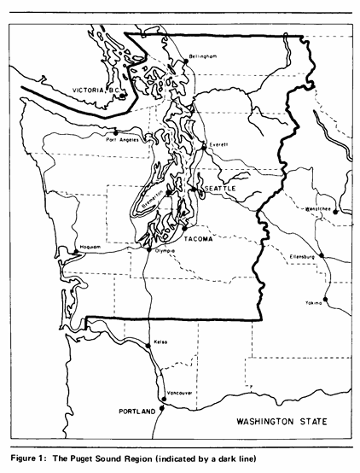
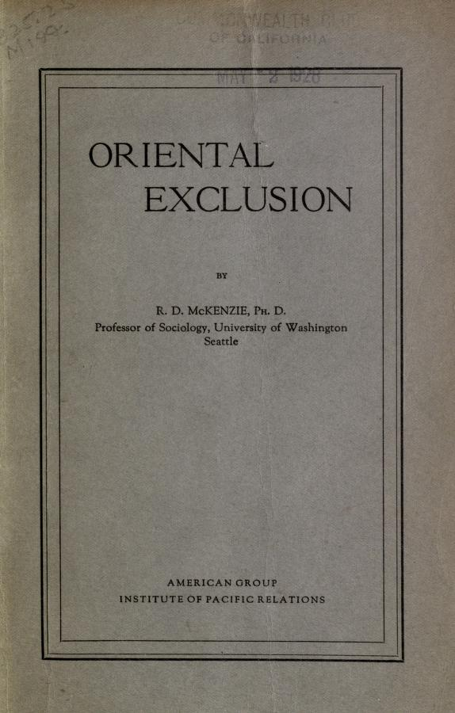
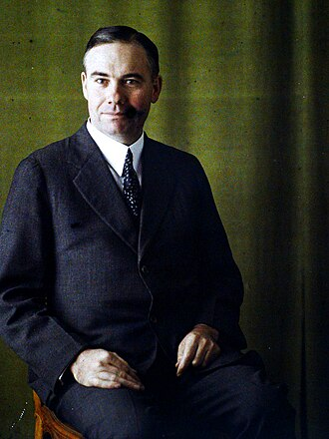
Roderick McKenzie (1885-1940)
UW Sociology Chair: 1921-30
Notes:
Chicago school – student of Robert Park, father of human ecology, also race relations, 1927 monograph on
International migration – treatment of Chinese

Slide 4
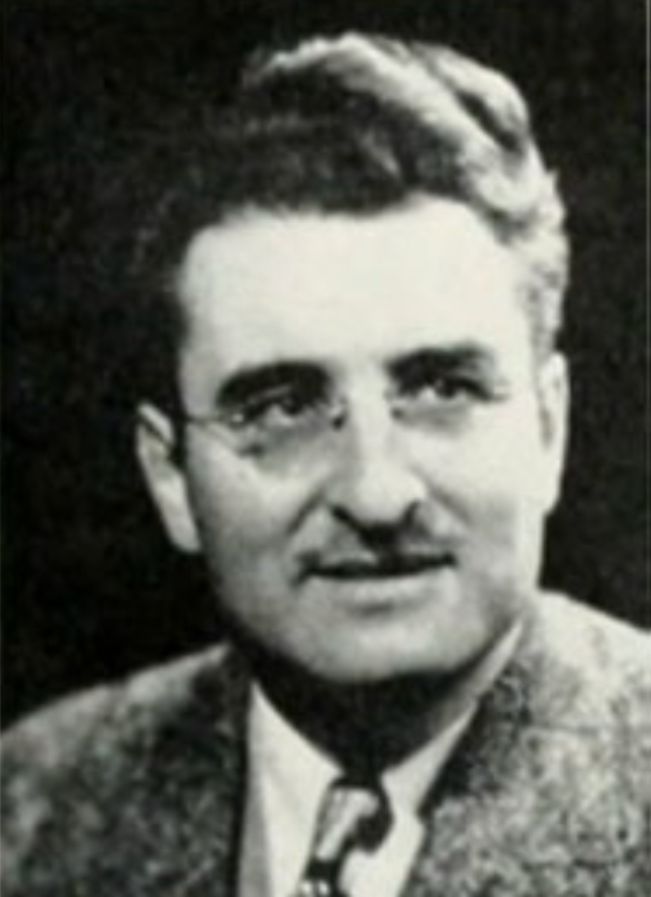
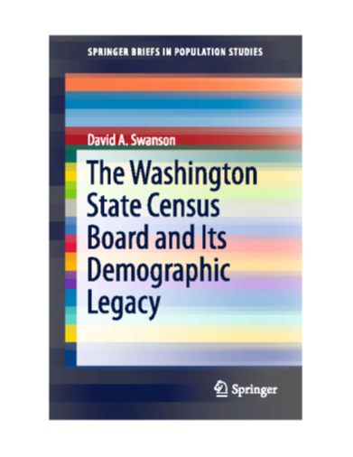
Cavin F. Schmid, Founder/Director
UW Office of Population Research, 1947-67
Calvin Schmid (1902-1994)
BA UW (1925), PhD Pittsburg (1930); 6 yrs Minnesota, UW Professor (1937-72):
Urban ecologist, exceptional skill as graphic artist, books/articles, spatial patterns of
  demographic, housing, race/ethnic patterns, suicide/homicide/crime
1943 Washington State Census Board – response to wartime pop growth
Schmid (key player): innovative methods of pop estimation
Support for graduate students
1947 UW Office of Population Research: Princeton (1936) Chicago (1947)
Pop Estimates, projections of school enrollments
One man shop, with dozens of grad students, local censuses
Also published textbooks, monographs, scholarly articles
President, PSA, PAA, SRA
Legacy – 32 PhDs from 1945-73
Notes:
Calvin Schmid founder of OPR – CSDE, fascinating story,
32 PhDs, but a one man shop until 1960s

Slide 5
Schmid Era PhDs– selected examples
Walter T. Martin (1949), U of Oregon chair, president of PSA, studies of suicide and human ecology
Monroe Sirken (1950) PhD. Distinguished mathematical statistician/administrator at NCHS.
David Yaukey (1956) U of Mass, demography textbook, Pop Council: Lebanon, Chile, East Pakistan
Maurice “Don” Van Arsdol (1957) Director of Population Research Lab, USC
Warren E. Kalbach (1960) Founding father of Canadian Demography, Toronto Alberta
Ørjar Øyen 1962). Professor Oslo and University of Bergen (Rector 1978-1983)
George C Myers (1963) Director of Duke University Center. Aging.

Slide 6
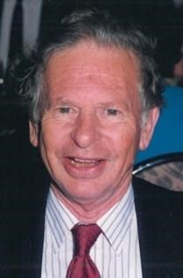
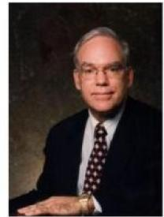

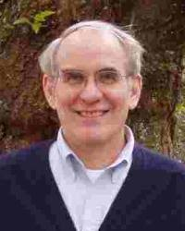
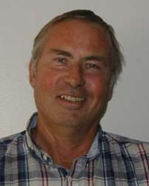
Center for Studies in Demography and Ecology
1967 to 1997
Stan Lieberson
Director, 1967-72
Sam Preston
Director, 1972-77
Tom Pullum
Director, 1977-87
Charles Hirschman
Director, 1987-95
Avery “Pete” Guest
Director, 1995-97

Slide 7
Stanley Lieberson– Social Demographer PolyMath
Lieberson arrives in 1967, age 34, from the other UW (Madison)
National reputation--race/ethnicity, segregation, race riots, methods
  Career Bio–ASA president, elected to NAS, pathbreaking books: “A Piece of the Pie,” “Making It Count,” “From Many Strands,” “A Matter of Taste.”
Office of Population Research becomes CSDE, but also cultural change
  From State/Local to National/International, Drafting Room becomes Machine Room
  Washington State Census Board moves to Olympia
  CSDE Faculty: Fred Campbell, Jim McCann, Pete Guest (arrives in 1972)
  NIGMS Training Grant – prior to NICHD program
Dept of Sociology – The Blalock-Costner Era
Lieberson’s pathbreaking research in the late 60s/early 70s (partial)
  Language & Ethnic Relations in Canada (John Wiley, 1970, 264 pp.)
  “An Empirical Study of Military-Industrial Linkages” AJS
  1972 “Leadership and Organizational Performance…” ASR

Slide 8
Sam Preston– Formal Demographer with flair
Preston arrives in 1982, age 29(PhD- 3 yrs, asst to full prof - 7 yrs)
Whiz kid: PAA President (age 41), NAS, AAAS, Am Academy, IUSSP Laureate, Mindel Ships and Irene Taeuber Awards, multiple terms as Chair/Director, returns to active career after serving as Penn Dean
17 books and 300 plus articles that advanced formal demography and addressed major empirical questions
1972-77 at the University of Washington:
  NICHD Center and Training Grants
    Economics (Douglas North) Biostatistics (Ed Perrin), JSIS (Susan Hanley)
  3 books, many articles, including one that introduced the “Preston Curve” of relationship of life expectancy and GDP per capita (2,600 citations)
  Creates first PUS from Historical Manuscript 1900 Census

Slide 9
Selected CSDE affiliated PhDs 1970s/1980s
Murray Chapman (Geography)1970
Robert J. Willis (Economics) 1971
Barbara Reskin 1973
James L Weed 1973
Lynn K White. 1975
Christopher Cluett 1977
Toby Parcel 1977
Alberto Palloni 1977
Elizabeth Thomson 1979
Barrett Lee 1980
Susan Long 1980
Stewart Tolnay 1981
Mary Brinton 1986
Daniel Klepinger 1986/1987
Nancy Landale 1987
Ralph “Sal” Oropesa 1987
Jerald Herting 1987

Slide 10
1980s and 1990s
Lieberson and Preston—impossible act to follow, lost NICHD funding, but still excellent training and research, less charisma
Pete Guest (editor, Demography), Jim McCann, Bill Lavely (1982), Adrian Raftery (1986), Charles Hirschman (1987), Diane Lye (1988), Economics (Robert Pollak, Shelly Lundberg, Robert Plotnick, Anil Deolalikar), Geography (Richard Morrill, David Hodge, Kam Wing Chan), JSIS (Sue Hanley), Anthropology, Social Work
Battelle Population Center (Steve McLaughlin, John Billy, Bill Grady, Dan Klepinger, Koray Tanfer)
Hewlett, Mellon, NICHD (training) grants, almost center grant
Professional staff (admin ass’t, systems analyst, librarian)
1990s College hiring initiative: Bettina Shell Duncan, Darryl Holman
Kathleen O’Connor, Mark Ellis, Martina Morris, Mark Hancock, Stew Tolnay

Slide 11
Some CSDE affiliated PhDs 1990s
Satomi Kurosu 1990
Gunnar R. Almgren 1990
Karin Brewster 1991
Xinhua Ren 1992
Timothy Biblarz 1992
Townsand Price Spratlen 1993
Steven Lewis (Statistics)1994
Jon Hussey 1995
David Nickinovich 1996
Yih-Jin Young 1997
Mark Edwards 1997
Guo Jie 1997
Rachel Silvey (Geography) 1997
Loi Manh Vu 1998
Minh Huu Nguyen 1998
Marc Bolan 1999
Jennifer L. Ward-Batts 1999
Debra Fogarty 1999

Slide 12
CSDE Postdoctoral Fellows
William Frey, 1974-75
Phillip Guest, 1986-89
Akbar Aghajanian, 1988-91
JooEan Tan 1991-94
Jiang Hong Li, 1992-94
Mark J Vanlandingham, 1993-96
Nguyen Minh Thang, 1993-96
Sara Curran, 1994-96
Steven Lewis 1994-96
Giovanna Merli, 1996-98
Anthony Perez, 2006-2009
Nikolas Pharris Ciurej, 2010-2012
Susie Cassels, 2008-2010

Slide 13
Reflections
2000s – “Peak CSDE” NICHD funding for 20 yrs, 200 plus CSDE affiliates, Demography
Early 20th c. Pacific NW was remote, but one of earliest soc dept (esp. West Coast), several distinguished faculty
Schmid Era: innovative & very successful, but a specialized niche
1960s/1970s – came very close to being one of top centers, but UW lacked $$ and vision to expand
1980s &1990s, uneven progress, but UW made investment in growth

