Slide 1

A NEW APPROACH TO PROBABILISTIC POPULATION FORECASTING WITH AN EXAMPLE APPLICATION TO ESTONIA
David A. Swanson
Population Research Center, Portland State University
Center for Studies in Demography and Ecology, University of Washington Department of Sociology, University of California Riverside
dswanson@ucr.edu
Jeff Tayman
Tayman Demographics
San Diego, CA
jtayman@san.rr.com

Slide 2
DECLARATIONS
The data underlying this paper are secondary and available from the corresponding author.
This research was not funded by any agency.
The authors have no conflicting interests in regard to this paper.
An ethics approval statement is not applicable because the data used are secondary and no human subjects review was required.
A patient consent statement is not applicable.
A clinical trial registration statement is not applicable because no human subjects were involved.
AI was not employed.
A statement regarding permission to reproduce material from other sources is not applicable because no excerpts from copyrighted works owned by third parties are included.
We thank Luule Sakkeus and her colleagues at the Estonian Institute for Population Studies, Tallinn University, for comments and suggestions on an earlier version of this paper.

Slide 3
OUTLINE
INTRODUCTION
A NEW APPROACH
METHODS
RESULTS
DISCUSSION
CONCLUSION

Slide 4
INTRODUCTION
This paper shows how measures of uncertainty can be applied to existing population forecasts using Estonia as a case study. The measures of forecast uncertainty are relatively easy to calculate and meet several important criteria used by demographers who routinely generate population forecasts. This paper applies the uncertainty measures to a population forecast based on the Cohort-Component Method, which links the probabilistic forecast uncertainty to demographic theory, an important consideration in developing accurate forecasts. We applied this approach to world population projections and compared the results to the Bayesian-based probabilistic world forecast produced by the United Nations, which we found to be similar but with more uncertainty than found in the latter. We did a similar comparison in regard to sub-national probabilistic forecasts and found our results to be similar with Bayesian-based uncertainty measures. These results suggest that the probability forecasts produced using our approach for Estonia are consistent with knowledge about forecast uncertainty. We conclude that this new method appears to be well-suited for developing probabilistic world, national, and sub-national population forecasts.

Slide 5
INTRODUCTION
In a seminal paper, Alkema et al. (2015) describe a Bayesian approach that links probabilistic uncertainty to a world population forecast based Cohort-Component Method (CCM). It proceeds by assembling a large sample of future trajectories for an outcome such as the total population size. The point projection in a given year is the median outcome of the sample trajectories. Other percentiles are used to construct prediction intervals (Alkema et al., 2015: 2). More details on this approach are found in Raftery, Alkema, & Gerland (2014) and a general overview of probabilistic population forecasting can be found in Raftery & Ševčíková (2023).

Slide 6
INTRODUCTION
Because the Bayesian approach described by Alkema et al. (2015) is based on the CCM, its measures of uncertainty are linked to the “fundamental equation,” whereby a population at a given point in time, P_{t+k}, is equal to the population at an earlier point in time, P_{t}, to which is added the births and in-migrants that occur between time t and time t+k and to which is subtracted the deaths and out-migrants that occur during this same time period (Baker et al., 2017: 251–252).
The fundamental equation is the cornerstone of demographic theory and is the foundation upon which the CCM rests (Baker et al., 2017; Burch, 2018). A probabilistic approach to population forecasting based on this theoretical foundation yields benefits not found in methods lacking this foundation (see e.g., Burch, 2018; Land 1986). This observation also is consistent with one made by Swanson et al. (2023), who argue that a given method’s strengths and weaknesses largely stem from four sources: (1) Its correspondence to the dynamics by which a population moves forward in time; (2) the information available relevant to these dynamics; (3) the time and resources available to assemble relevant information and generate a forecast; and (4) the information needed from the forecast.

Slide 7
A NEW APPROACH
We describe an approach for constructing uncertainty measures that is relatively simple and linked directly to the CCM approach. Importantly, unlike Bayesian inference, we believe it is likely to meet important evaluation criteria used by state and local demographers (Smith, Tayman, and Swanson, 2013: 301- 322): Low production costs (particularly staff time); easy to apply and easy to explain; a high level of face validity; and intuitive. The approach we suggest employs the ARIMA (Auto-Regressive Integrated Moving Average) Time Series method in conjunction with work by Espenshade and Tayman (1982) whereby we can translate the uncertainty information found in the ARIMA method’s forecast to the population forecast provided by the CCM approach.
As our brief review suggests, the Bayes CCM approach comes with strengths. However, it also comes with weaknesses. Goodwin (2015) finds Bayesian inference to be difficult, effortful, opaque, and even counter-intuitive. Along with the weaknesses described by Goodwin’s (2015) are implied ones, including being not easy to apply or explain, and having a low level of face validity and high production costs in that a Bayes CCM approach is very data-and analytically-intensive.

Slide 8
A NEW APPROACH
. In describing this new approach, we use an Estonian population forecast with a horizon of 2060. It is found at the International Data Base (IDB) site of the U.S. Census Bureau (https://www.census.gov/data-tools/demo/idb/#/table?COUNTRY_YEAR=2024&COUNTRY_YR_ANIM=2024&menu=tableViz ). Documentation on the data and methods is found in U.S. Census Bureau (2020).

Slide 9
METHODS & DATA
The approach we suggest employs the ARIMA (Auto-Regressive Integrated Moving Average) Time Series method in conjunction with work by Espenshade and Tayman (1982) whereby we can translate the uncertainty information found in the ARIMA method’s forecast to the population forecast provided by the CCM approach. We describe neither the ARIMA (Box & Jenkins, 1976) nor the CCM approach (Smith, Tayman, & Swanson, 2013) in any detail because they are so widely known and used.

Slide 10
METHODS & DATA
Before turning to a description of the “transfer of uncertainty,” we first clarify our use of the term “confidence interval” in regard to forecast uncertainty. It is more common to use the term “forecast interval” or “prediction interval” in the context of forecasting because a “confidence interval,” strictly speaking, applies to a sample (Swanson and Tayman, 2014: 204). However, underlying the approach we describe herein is the concept of a “superpopulation,” which, as discussed later, describes a population that is but one sample of the infinity of populations that will result by chance from the same underlying social and economic cause systems (Deming and Stephan, 1941). The concept of viewing a forecast as a sample leads us to choose “confidence interval” rather than forecast or prediction interval because it distinguishes the approach we propose from those mentioned earlier.

Slide 11
METHODS & DATA
We use annual historical data of total population and land area for Estonia in square meters to compute population density annually from 1950 to 2020 found at the IDB site to implement the ARIMA model and launch from the annual Estonian forecasts found at the same site for 2021-2060. We use “density” because the Espenshade-Tayman (1982) method for translating uncertainty information does so from an estimated “rate,” which in this case is the “rate” of population density. Thus, the 95% confidence intervals generated by the ARIMA world “density” forecasts are translated to the CCM-based Estonian population forecast. Here is an example of this process using the 2050 forecast data found at the IDB site.

Slide 12
METHODS & DATA
Let P = forecasted Estonian population (at time t) obtained from the forecast,
Let D = forecasted Estonian population density obtained from ARIMA at time t, and
Let A = land area of Estonia (42,388 square kilometers).
The 2050 ARIMA density forecast shows 14.5436, 25.2596, and 35.3582 persons per square kilometer, respectively, for the land area of Estonia as a whole (95% Lower Limit of forecasted D, forecasted D, and 95% Upper Limit of forecasted D, respectively).
The relative widths of the Upper and Lower Limits are -0.4242 and 0.4242, respectively.
The 2050 Estonia forecast found at IDB is 970,580
Multiplying 970,580 by -.4242 and adding this product to 970,580 yields 558,826, the 95% Lower Limit, and adding the product 979,580 × .4224 to 9970580 yields 1,382,334, the 95% Upper Limit of the 2050 Estonian population forecast found at IDB.
Putting it all together, we can state that we are 95% certain that the 2050 Estonian forecast found at IDB is between 558,826 and 1,382,334

Slide 13
METHODS & DATA
As alluded to earlier, underlying the Espenshade-Tayman method is the idea that there is a sample taken from a population of interest. In this case, the ARIMA results represent the sample, and the CCM forecasts represent the population. This interpretation is derived from the idea of a “superpopulation” (Hartley & Sielken, 1975; Sampath, 2005; Swanson & Tayman (2012: 32-33). This concept can be traced at least back to Deming and Stephan (1941) who observed that even a complete census, for scientific generalizations, describes a population that is but one of the infinity of populations that will result by chance from the same underlying social and economic cause systems. The use of the Espenshade-Tayman method (1982) here is not new. In addition to being employed by Espenshade and Tayman (1982), it has been used by Swanson (1989) and Roe, Swanson, and Carlson (1992) in demographic applications.

Slide 14
RESULTS USING 95% INTERVALS

Slide 15
DISCUSSION
As is the case with the Bayesian approach described by Alkema et al. (2015), the new approach we propose can be linked directly to the CCM method (as well as forecasts produced by other methods such as the Cohort Change Ratio approach, which, inherently, are not conjoined with a method for generating statistical uncertainty). However, unlike the Bayesian approach, it is simple and neither opaque nor counter-intuitive, criticisms directed at Bayesian methods by Goodwin (2015). Importantly, the ARIMA method is widely available on the software packages generally used by demographers.

Slide 16
DISCUSSION
Considering the discussion of data assembly and analysis (Alkema et al., 2015, United Nations, 2022, Yu et al., 2023), it is clear that far more time and resources are required for a Bayesian probabilistic forecast than for the probabilistic forecasting method we have described here. In addition, as characterized by Goodwin (2015) Bayesian inference is difficult, effortful, opaque, and even counter-intuitive, none of which applies to the method we have described in this paper.

Slide 17
DISCUSSION
The approach we propose does not produce the uncertainty intervals by age and gender, births, death, and migration as does the Bayes CCM approach described by Yu et al. (2023: 934) and the CCR approach discussed by Swanson and Tayman (2014). Neither the Bayes CCM nor our approach, however, take into account uncertainty in the input data themselves, a similarity also shared with the work by Cameron and Poot (2011); Swanson and Tayman (2014); and Wilson (2012). However, as implied by Yu et al. (2023: 934), these are not likely to be among the most important sources of uncertainty for data in the United States and other countries in which subnational population forecasts are routinely produced.

Slide 18
DISCUSSION
In regard to our approach not providing uncertainty intervals by age and gender, Deming’s (1950: 127-134) “error propagation” was used to translate uncertainty in age groups intervals found in the regression-based CCR forecasts reported by Swanson and Tayman (2014) to the total populations in question. In different forms “error propagation” has been used by used by Alho and Spencer (2005), Espenshade and Tayman (1982), and Hansen, Hurwitz, and Madow (1953), among others.

Slide 19
DISCUSSION
It may be possible to reverse-engineer error propagation and develop uncertainty measures by age and gender using our approach. The validity of this could be explored to determine if it is viable. As an approximation, one could generate age uncertainty intervals by controlling “low” and “high” numbers in a given forecast series to their corresponding 95% lower and upper limits, respectively, found using our proposed approach. The United Nations, for example, publishes not only probabilistic population forecasts but also a medium, low, and high series (United Nations, 2022).

Slide 20
DISCUSSION
We (Swanson and Tayman, 2025) applied this approach to world population projections and compared the results to the probabilistic world forecast produced by the United Nations, which we found to be similar but with more uncertainty than found in the latter. We (Swanson and Tayman, 2024) also used historical data produced by the Forecasting Division of the Office of Financial Management (Washington, 2024) to implement the ARIMA model, which we then applied to the medium series of the “Growth Management Act” projections produced by the Office of Financial Management (Washington, 2022).

Slide 21
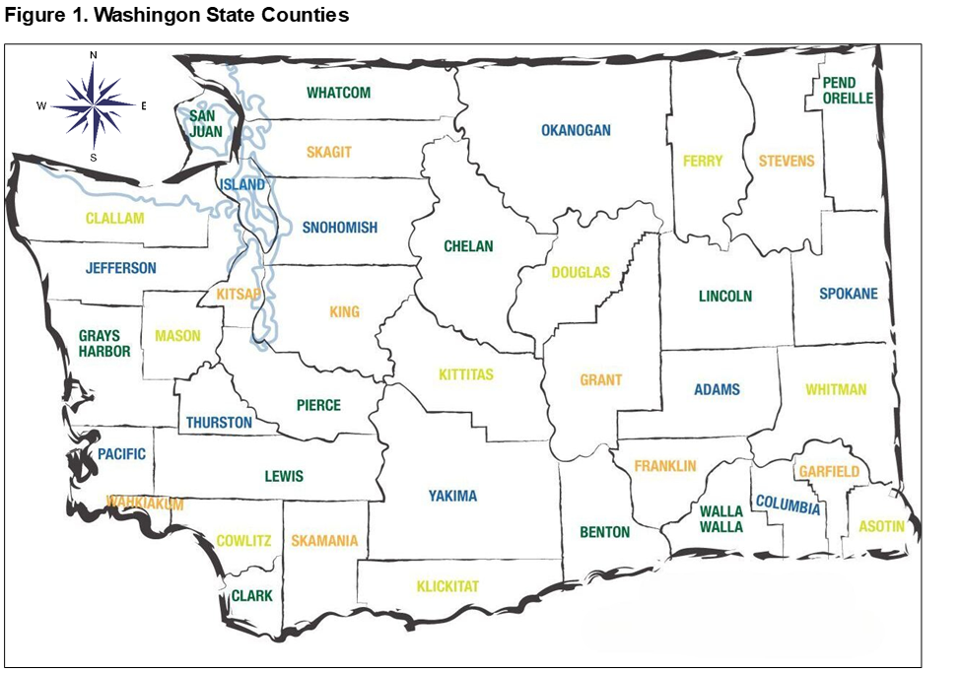

Slide 22
DISCUSSION
We examined the range of uncertainty in the county forecasts by analyzing half-widths and compared the half-widths of their ARIMA-based intervals to half-widths produced using a Bayesian approach by Yu et al. (2023, who discussed their results for the state as a whole and to three counties, Ferry, King, and Whitman.

Slide 23
DISCUSSION
The ARIMA-based half-widths for Ferry county (a county with a very small population, approximately 7,500 currently) were found to be wider than those for the Bayes CCM approach at each of the three horizon lengths, 10, 20, and 30 years. For King county (the county with the highest current population of Washington’s counties, approximately 2.7 million), the ARIMA-based half-widths were slightly narrower at 10 years than those found for the Bayes CCM approach and substantially narrower at 20 and 30 years.

Slide 24
DISCUSSION
For Whitman County (which has a current population of approximately 48,000, of which 27,000 or so are students at Washington State University), the Bayes-based CCM produced narrower widths at each of the three horizon lengths. However, we noted that Yu et al. (2023: 921-922) held the age groups associated with college attendance constant in counties such as Whitman where these populations have a large impact on the age structure of the county as a whole.

Slide 25
DISCUSSION
Considering Washington State as a whole (with a population of approximately 7.9 million), we found that the half-widths generated by the Bayes CCM were narrower for the 10- and 20-year horizon than the ARIMA-based half-widths, while the latter produced a narrower half-width for the 30-year horizon length. Importantly, for all three counties and the state as a whole, the ARIMA-based half-widths increased over time in a manner consistent with the Bayes CCM half-widths.

Slide 26
DISCUSSION
We (Swanson and Tayman, 2024) concluded that the ARIMA-based approach produces uncertainty measures for county population forecasts that are not dissimilar to those produced by the Bayes CCM approach and that neither produced intervals so wide as to be useless, a point brought up by Swanson and Tayman (2016) in an earlier examination of forecast uncertainty.

Slide 27
DISCUSSION
As a final note, Swanson and Tayman (2014) argued that 95% CIs are likely too wide to be of use and recommended that 66% CIs be considered. The following table shows the results for Estonia using 66% CIs, which in our opinion are preferable to the 95% CIs shown earlier

Slide 28
RESULTS USING 66% CI

Slide 29
CONCLUSION
Smith, Tayman, and Swanson (2002:373) opined that future research would focus increasingly on the measurement of uncertainty in population forecasts and noted that while such research may not directly improve forecast accuracy, it will enhance our understanding of the uncertainty inherent in population forecasts. They went on to note that this change will imply a shift from ‘‘population projections’’ to ‘‘population forecasts,” a guideline we have followed in this paper.

